Slide 1
Applications of Big Data
Notes:
本章主要介绍。主要内容包括
大数据概述：介绍大数据的基本概念、特征和技术框架；
大数据的模式：介绍大数据的实时计算和离线计算两种模式；
腾讯云大数据产品体系：介绍腾讯云大数据的各个产品和服务；
腾讯云大数据EMR解决方案：介绍腾讯云弹性MR的大数据解决方案。

Slide 2
Objectives
After completing this course, you will be able to:
Understand the basic concepts, characteristics, and technology framework of big data;
Understand the offline and real-time computing modes of big data;
Understand the Tencent Cloud big data product system;
Understand the Tencent Cloud EMR solution.
Notes:
培训对象：云架构师，参加此培训需要先学习腾讯云架构工程师课程。

Slide 3
Section 1. Overview of Big Data
Section 2. Modes of Big Data
CONTENTS
Section 3. Tencent Cloud Big Data Service System
Section 4. Tencent Cloud EMR Solution

Slide 4
Section 1. Overview of Big Data
Section 1. Evolution of Cloud Computing
1.1 Introduction to big data
CONTENTS
1.2 Core big data industries
1.3 Technology framework of big data
1.4 Big data solutions

Slide 5
1.1 Introduction to big data
Definition of big data
According to Wikipedia, "big data" refers to such a massive amount of data that cannot be extracted, managed, processed, and organized into information that helps organizations make business decisions through currently popular software tools within a reasonable period of time.
Gartner, a leading big data research company, defines big data as high-volume, high-velocity, and/or high-variety information assets that demand cost-effective, innovative forms of information processing that enable enhanced insight, decision making, and process automation.
Analyzes large volumes of data
Helps enterprises make decisions
Integrates with businesses to create new value
Definition of big data
Notes:
大数据主要被用于分析和决策，企业用以分析的数据越全面，分析的结果就越接近于真实。大数据分析意味着企业能够从这些新的数据中获取新的洞察力，并将其与已知业务的各个细节相融合，对企业产生新的价值。

Slide 6
1.1 Introduction to big data (continued)
Background of big data
Rapid growth of data volume and diversified sources of data, such as web logs, audios, videos, images, and location information
Recognition of the research value and economic benefits of effective utilization of massive amounts of data
Lower information storage costs
The cost of information storage has decreased from 10,000 USD per MB in 1960s to 1 cent per GB now
The big data revolution would not have taken place if the storage costs were not reduced
Popularity of smart devices
WeChat is used on over 1 billion unique devices, and QQ is used on over 660 million unique devices

Slide 7
1.1 Introduction to big data (continued)
Characteristics of big data
Volume
Velocity
Efficiency
The volumes of enterprise data are mostly at the TB level or above, and data volumes in industries such as banking and telecommunications are at the PB level or above and are growing at a rate of 40% every year
Analysis results must be provided within seconds; otherwise, data will lose its value
Cost
Value
4V
Variety
Veracity
Structured data such as text, semi-structured data represented by webpage data, and unstructured data such as web logs, audios, videos, images, and location information
How can we use strong machine algorithms to "purify" the value of massive amounts of data more quickly and effectively?
Notes:
4V：Volume:体量大；Variety:样式多；Velocity:速度快；Valueless:价值密度低。

Slide 8
1.2 Core big data industries
Core big data industries
Data
Products
Services
Any company can become a data company
Open-Source vendors and traditional closed-source vendors
Mass entrepreneurship
Data flow platform providers
Data sharing platforms, open data platforms, and data trading platforms
Application software
Analysis software, security software, etc.
Application services
Government applications, industry applications, lifestyle applications, and enterprise applications
Basic software
Structured databases, unstructured databases, etc.
Data sources and API providers
Government data, enterprise data, personal data, and APIs
Technical and OPS support
Data analysis services
Data processing and analysis services
Hardware
Servers, storage, network devices, micromodules, etc.
Infrastructure services
Data center and network services
Notes:
大数据核心产业为 全社会大数据应用提供数据资源、产品工具和应用服务，支撑各个领 域的大数据应用，是大数据在各个领域应用的基石。
数据资源部分负责原始数据的供给和交换，根据数据来源的不同， 可以细分为数据资源提供者和数据交易平台两种角色。 数据基础能力部分负责与数据生产加工相关的基础设施和技术 要素供应，根据数据加工和价值提升的生产流程，数据基础能力部分 主要包括数据存储、数据处理和数据库（数据管理）等多个角色。 数据分析/可视化部分负责数据隐含价值的挖掘、数据关联分析 和可视化展现等，既包括传统意义上的 BI、可视化和通用数据分析 工具，也包括面向非结构化数据提供的语音、图像等媒体识别服务。 数据应用部分根据数据分析和加工的结果，面向电商、金融、交 通、气象、安全等细分行业提供精准营销、信用评估、出行引导、信 息防护等企业或公众服务。--《大数据白皮书》，中国信通院

Slide 9
1.3 Technology framework of big data
Five steps involved in big data implementation
Data preparations
Data storage and management
Computing
Data is cleansed and organized, which is called "extract, transform, and load (ETL)" in the traditional data processing system
Massive amounts of data are stored at very low costs for adaptation to diversified unstructured data and for scalability in data formats
Appropriate algorithm models are used based on the types of the data to be processed and the analysis goals to quickly process data
Data analysis
Knowledge presentation
Data analysis involves discovering patterns and extracting new knowledge from complex data
In scenarios where big data provides support for decision making, analysis results are presented to users in an intuitive way
Notes:
大数据来源于互联网、企业系统和物联网等信息系统，经过大数 据处理系统的分析挖掘，产生新的知识用以支撑决策或业务的自动智 能化运转。从数据在信息系统中的生命周期看，大数据从数据源经过 分析挖掘到最终获得价值一般需要经过 5 个主要环节，包括数据准备、 数据存储与管理、计算处理、数据分析和知识展现，技术体系如图 1 所示。每个环节都面临不同程度的技术上的挑战。
数据准备环节：在进行存储和处理之前，需要对数据进行清洗、整理，传统数据处理体系中称为 ETL （ Extracting ， Transforming，Loading）过程。与以往数据分析相比，大数据的来源多种多样，包括企业内部数据库、互联网数据和物联 网数据，不仅数量庞大、格式不一，质量也良莠不齐。这就要 求数据准备环节一方面要规范格式，便于后续存储管理，另一 方面要在尽可能保留原有语义的情况下去粗取精、消除噪声。
数据存储与管理环节：当前全球数据量正以每年超过 50%的速 度增长，存储技术的成本和性能面临非常大的压力。大数据存 储系统不仅需要以极低的成本存储海量数据，还要适应多样化 的非结构化数据管理需求，具备数据格式上的可扩展性。
计算处理环节：需要根据处理的数据类型和分析目标，采用当的算法模型，快速处理数据。海量数据处理要消耗大量的计 算资源，对于传统单机或并行计算技术来说，速度、可扩展性和成本上都难以适应大数据计算分析的新需求。分而治之的分布式计算成为大数据的主流计算架构，但在一些特定场景下的实时性还需要大幅提升。
数据分析环节：数据分析环节需要从纷繁复杂的数据中发现规律提取新的知识，是大数据价值挖掘的关键。传统数据挖掘对 象多是结构化、单一对象的小数据集，挖掘更侧重根据先验知识预先人工建立模型，然后依据既定模型进行分析。对于非结 构化、多源异构的大数据集的分析，往往缺乏先验知识，很难建立显式的数学模型，这就需要发展更加智能的数据挖掘技术。

Slide 10
Notes:
知识展现环节：在大数据服务于决策支撑场景下，以直观的方式将分析结果呈现给用户，是大数据分析的重要环节。如何让 复杂的分析结果易于理解是主要挑战。在嵌入多业务中的闭环大数据应用中，一般是由机器根据算法直接应用分析结果而无 需人工干预，这种场景下知识展现环节则不是必需的。
来源：《大数据白皮书》- 工业和信息化部电信研究院

Slide 11
1.3 Technology framework of big data (continued)
User
Data visualization
Knowledge presentation
Data mining (data warehouses, OLAP, business intelligence, etc.)
Data analysis
Big data
processing system
Batch
processing
Interactive
analysis
Stream
processing
Computing
Data storage (SQL and NoSQL)
Storage management
Data import (ETL)
Data preparations
Data source (internet, IoT, enterprise data, etc.)

Slide 12
1.4 Big data solutions
Big data solutions
Data application
Machine learning and data mining
Superset
ETL scheduling
Azkaban
Airflow
Elasticsearch
Access interaction
Hive
Kylin
Zeppelin
Computing framework
MR
Spark
Storm
Flink
Resource allocation
HBase
YARN
Mesos
Kafka
Storage
HDFS
Notes:
大数据解决方案：从存储、资源分配、计算框架、接入交互、ETL调度和数据应用6个层面介绍大数据的解决方案。上述的解决方案都是开源的产品和服务，大部分都是Apache的开源项目。目前很多大数据的产品都是基于这些开源项目进行开发，从而实现企业自己的大数据产品。
存储层面的解决方案包括：HDFS；
资源分配层面的解决方案包括：YARN、MESOS；
计算框架层面的解决方案包括：MR、Spark、Storm和Flink；
接入交互层面的解决方案包括：Hive、Kylin、Zeppelin和PHOENIX；
ETL调度层面的解决方案包括：Azkaban、Oozie和Airflow；
数据应用层面的解决方案包括：Superset、机器学习和数据挖掘等。
而Hbase是支撑计算框架和资源分配的分布式开源数据库，Kafka是支撑计算框架、资源分配和存储的高吞吐量的分布式发布订阅消息系统，Elastic search是支撑数据应用、ETL调度和接入交互的分布式多用户的全文搜索引擎。

Slide 13
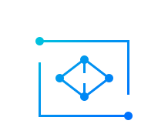
1.4 Big data solutions (continued)
Basic big data platform in the cloud environment
In-depth AI applications
Data visualization
Professional technical support
……
Business intelligence
PAAS
Intelligent recommendation
Visual big data interaction
High computing resource guarantee
Computing services
Hosted Hadoop computing service
Low OPS and development costs
Offline processing
Stream processing
Real-Time database
ETL
Computing-Storage separation
Cloud computing and networks
Cloud computing resources
Virtual network
Deep service integration
Elastic
Efficient
Massive
Secure
Efficient
Fast delivery
Cloud storage resources
Cloud storage
TencentDB
COS
KV storage
Document database
Resource elasticity
Notes:
云环境下的大数据基础平台：在云环境下的大数据平台的存储、计算、网络资源都是基于云，依赖于云端的资源可托管整套大数据平台，包括：离线处理、流式处理、实时数据库和ETL。在此基础上，云平台能够继续提供大数据的可视化产品和大数据的应用产品。在云环境下，整套大数据平台能够实现：资源弹性、快速交付、服务深度整合、计算存储分离、低运维和开发成本、海量计算资源保证和专业技术支持。

Slide 14
Section 2. Modes of Big Data
Section 1. Evolution of Cloud Computing
2.1 Big data processing modes
CONTENTS
2.2 Overview of offline computing
2.3 Overview of real-time computing

Slide 15
2.1 Big data processing modes
Offline and real-time computing
2. Request submission
Offline computing
2. Real-Time data streaming
Real-Time computing
3. Real-Time result streaming
1. Data load
3. Result returning
1. Streaming task submission
Offline computing is a batch, high-latency, and actively initiated computing task
Real-Time computing is a continuous, low-latency, and event-triggered computing task
MapReduce
Spark
Flink
Notes:
离线计算：离线计算就是在计算开始前已知所有输入数据，输入数据不会产生变化，且在解决一个问题后就要立即得出结果的前提下进行的计算。
实时计算：随着用户数据量的增加，离线的计算会越来越慢，很难满足用户在某些场景下的实时性要求，所以实时计算应运而生。实时计算与离线计算相对应，一般都是针对海量数据进行的，一般要求为秒级。

Slide 16
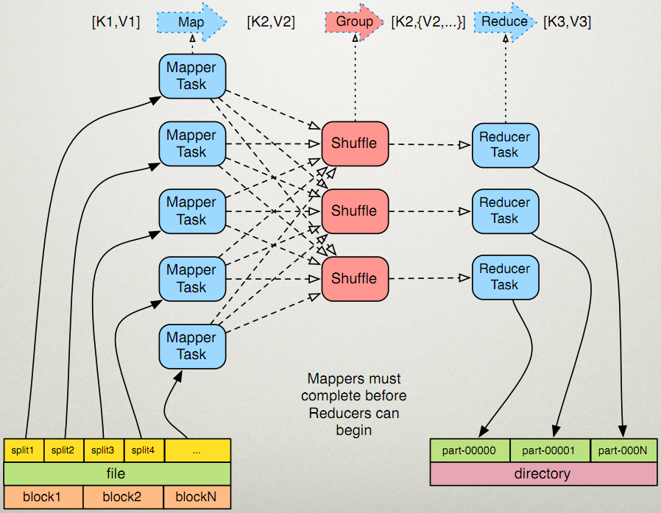
2.2 Overview of offline computing
MapReduce
Why MapReduce?
A single server is not capable of processing massive amounts of data due to hardware resource limitations
Extending a standalone program to a cluster for running in a distributed manner will significantly increase the complexity of the program and make it more difficult to develop
After the MapReduce framework is introduced, the complexity of distributed computing will be handled by the framework
How MapReduce works
Notes:
MapReduce原理
一个mr程序启动的时候，最先启动的是MRAppMaster，MRAppMaster启动后根据本次job的描述信息，计算出需要的maptask实例数量，然后向集群申请机器启动相应数量的maptask进程
maptask进程启动之后，根据给定的数据切片范围进行数据处理，主体流程为：
利用客户指定的inputformat来获取RecordReader读取数据，形成输入KV对
将输入KV对传递给客户定义的map()方法，做逻辑运算，并将map()方法输出的KV对收集到缓存
将缓存中的KV对按照K分区排序后不断溢写到磁盘文件
MRAppMaster监控到所有maptask进程任务完成之后，会根据客户指定的参数启动相应数量的reducetask进程，并告知reducetask进程要处理的数据范围（数据分区）
Reducetask进程启动之后，根据MRAppMaster告知的待处理数据所在位置，从若干台maptask运行所在机器上获取到若干个maptask输出结果文件，并在本地进行重新归并排序，然后按照相同key的KV为一个组，调用客户定义的reduce()方法进行逻辑运算，并收集运算输出的结果KV，然后调用客户指定的outputformat将结果数据输出到外部存储

Slide 17
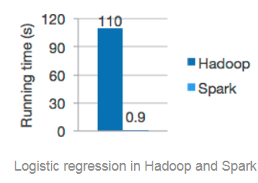
2.2 Overview of real-time computing
Apache Spark
Apache Spark, a big data processing framework built around speed, ease of use, and complex analysis, was initially developed at the AMPLab at University of California, Berkeley in 2009 and became one of Apache's open-source projects in 2010.
Spark
SQL
Spark
Streaming
MLlib (machine learning)
GraphX
(graph)
Apache Spark
Notes:
与Hadoop和Storm等其他大数据和MapReduce技术相比，Spark有如下优势
Spark提供了一个全面、统一的框架用于管理各种有着不同性质（文本数据、图表数据等）的数据集和数据源（批量数据或实时的流数据）的大数据处理的需求；
官方资料介绍Spark可以将Hadoop集群中的应用在内存中的运行速度提升100倍，甚至能够将应用在磁盘上的运行速度提升10倍。

Slide 18
2.3 Overview of real-time computing (continued)
Flink
Apache Flink is a framework and distributed processing engine for stateful computations over unbounded and bounded data streams. Flink has been designed to run in all common cluster environments and perform computations at in-memory speed and at any scale.
Notes:
任何类型的数据都是作为事件流产生的。信用卡交易，传感器测量，机器日志或网站或移动应用程序上的用户交互，所有这些数据都作为流生成。
数据可以作为无界或有界流处理
无界流有一个开始但没有定义的结束。它们不会在生成时终止并提供数据。必须连续处理无界流，即必须在摄取事件后立即处理事件。无法等待所有输入数据到达，因为输入是无界的，并且在任何时间点都不会完成。处理无界数据通常要求以特定顺序摄取事件，例如事件发生的顺序，以便能够推断结果完整性。
有界流具有定义的开始和结束。可以在执行任何计算之前通过摄取所有数据来处理有界流。处理有界流不需要有序摄取，因为可以始终对有界数据集进行排序。有界流的处理也称为批处理。

Slide 19
Section 3. Tencent Cloud Big Data Service System
Section 1. Evolution of Cloud Computing
3.1 Challenges faced by traditional data analysis
3.2 Tencent Cloud big data service system
CONTENTS
3.3 TBDS
3.4 Sparking
3.5 EMR
3.6 Oceanus
3.7 BI

Slide 20
3.1 Challenges faced by traditional data analysis
Challenges faced by traditional data analysis
Low efficiency in processing massive amounts of data
Poor capabilities to analyze real-time data
Scattered data and diverse data types and formats
How does big data technology address these problems?
It uses a distributed computing architecture to efficiently process massive amounts of data
It supports both offline and real-time computing
It can process structured and unstructured data of multiple types and formats
Notes:
传统的数据分析面临诸多难题
海量数据处理效率低：随着互联网发展，数据量增长速度非常快，传统的数据仓库处理海量数据的效率低；
实时数据分析能力差：传统数据分析需要等待提取、转换和加载（ETL）的过程，而无法很好地实现数据的实时分析；
数据分散、数据类型和格式多样：传统分析是建立在关系数据模型上，但目前企业的数据类型多样，不仅仅是结构化数据，还有大量非结构化数据，比如：图片、视频等等。

Slide 21
3.2 Tencent Cloud big data service system
Matrix of Tencent Cloud big data services
Big data application services
Enterprise Profile
Public Opinion Analysis
Smart Selection
Big data infrastructure
RayData
BI
EMR
Oceanus
Elasticsearch Service
TCS
Sparking
TBDS
Notes:
大数据基础设施
PB级数仓建设：大数据处理套件TBDS、云数据仓库套件 Sparking、弹性 MapReduce和商业智能分析 BI；
实时流式计算：流计算 Oceanus、弹性 MapReduce、大数据处理套件 TBDS；
搜索与检索分析：腾讯云Elasticsearch Service、腾讯云搜 TCS；
RayData：大数据可视交互系统 RayData。
大数据应用服务：
企业画像、公众趋势分析和智能选址。

Slide 22
3.3 TBDS
What is TBDS?
Tencent Big Data Suite (TBDS) is a reliable, secure, and easy-to-use big data processing platform provided by Tencent Cloud based on its many years of experience in processing massive amounts of data.
Applications of TBDS
Data warehouse construction
Real-Time streaming data processing
Offline data processing
Data analysis, exploration, and mining
TBDS involves various links in data warehouse construction such as data extraction, conversion, loading, modeling, analysis, report representation, and data governance
You can quickly develop big data processing and analysis applications in real-time streaming scenarios based on TBDS
TBDS can use technologies based on the Hadoop system to provide organizational users with powerful offline batch data processing capabilities
With TBDS, you can quickly and visually analyze and explore big data at the PB level
Notes:
腾讯大数据处理套件（Tencent Big Data Suite，TBDS）是基于腾讯多年海量数据处理经验，对外提供的可靠、安全、易用的大数据处理平台。您可以借助 TBDS 在公有云、私有云、非云化环境，根据不同数据处理需求选择合适的大数据分析引擎和相应的实时数据开发、离线数据开发以及算法开发服务，来构建您的数据仓库、用户画像、精准推荐、风险管控等大数据应用服务。

Slide 23
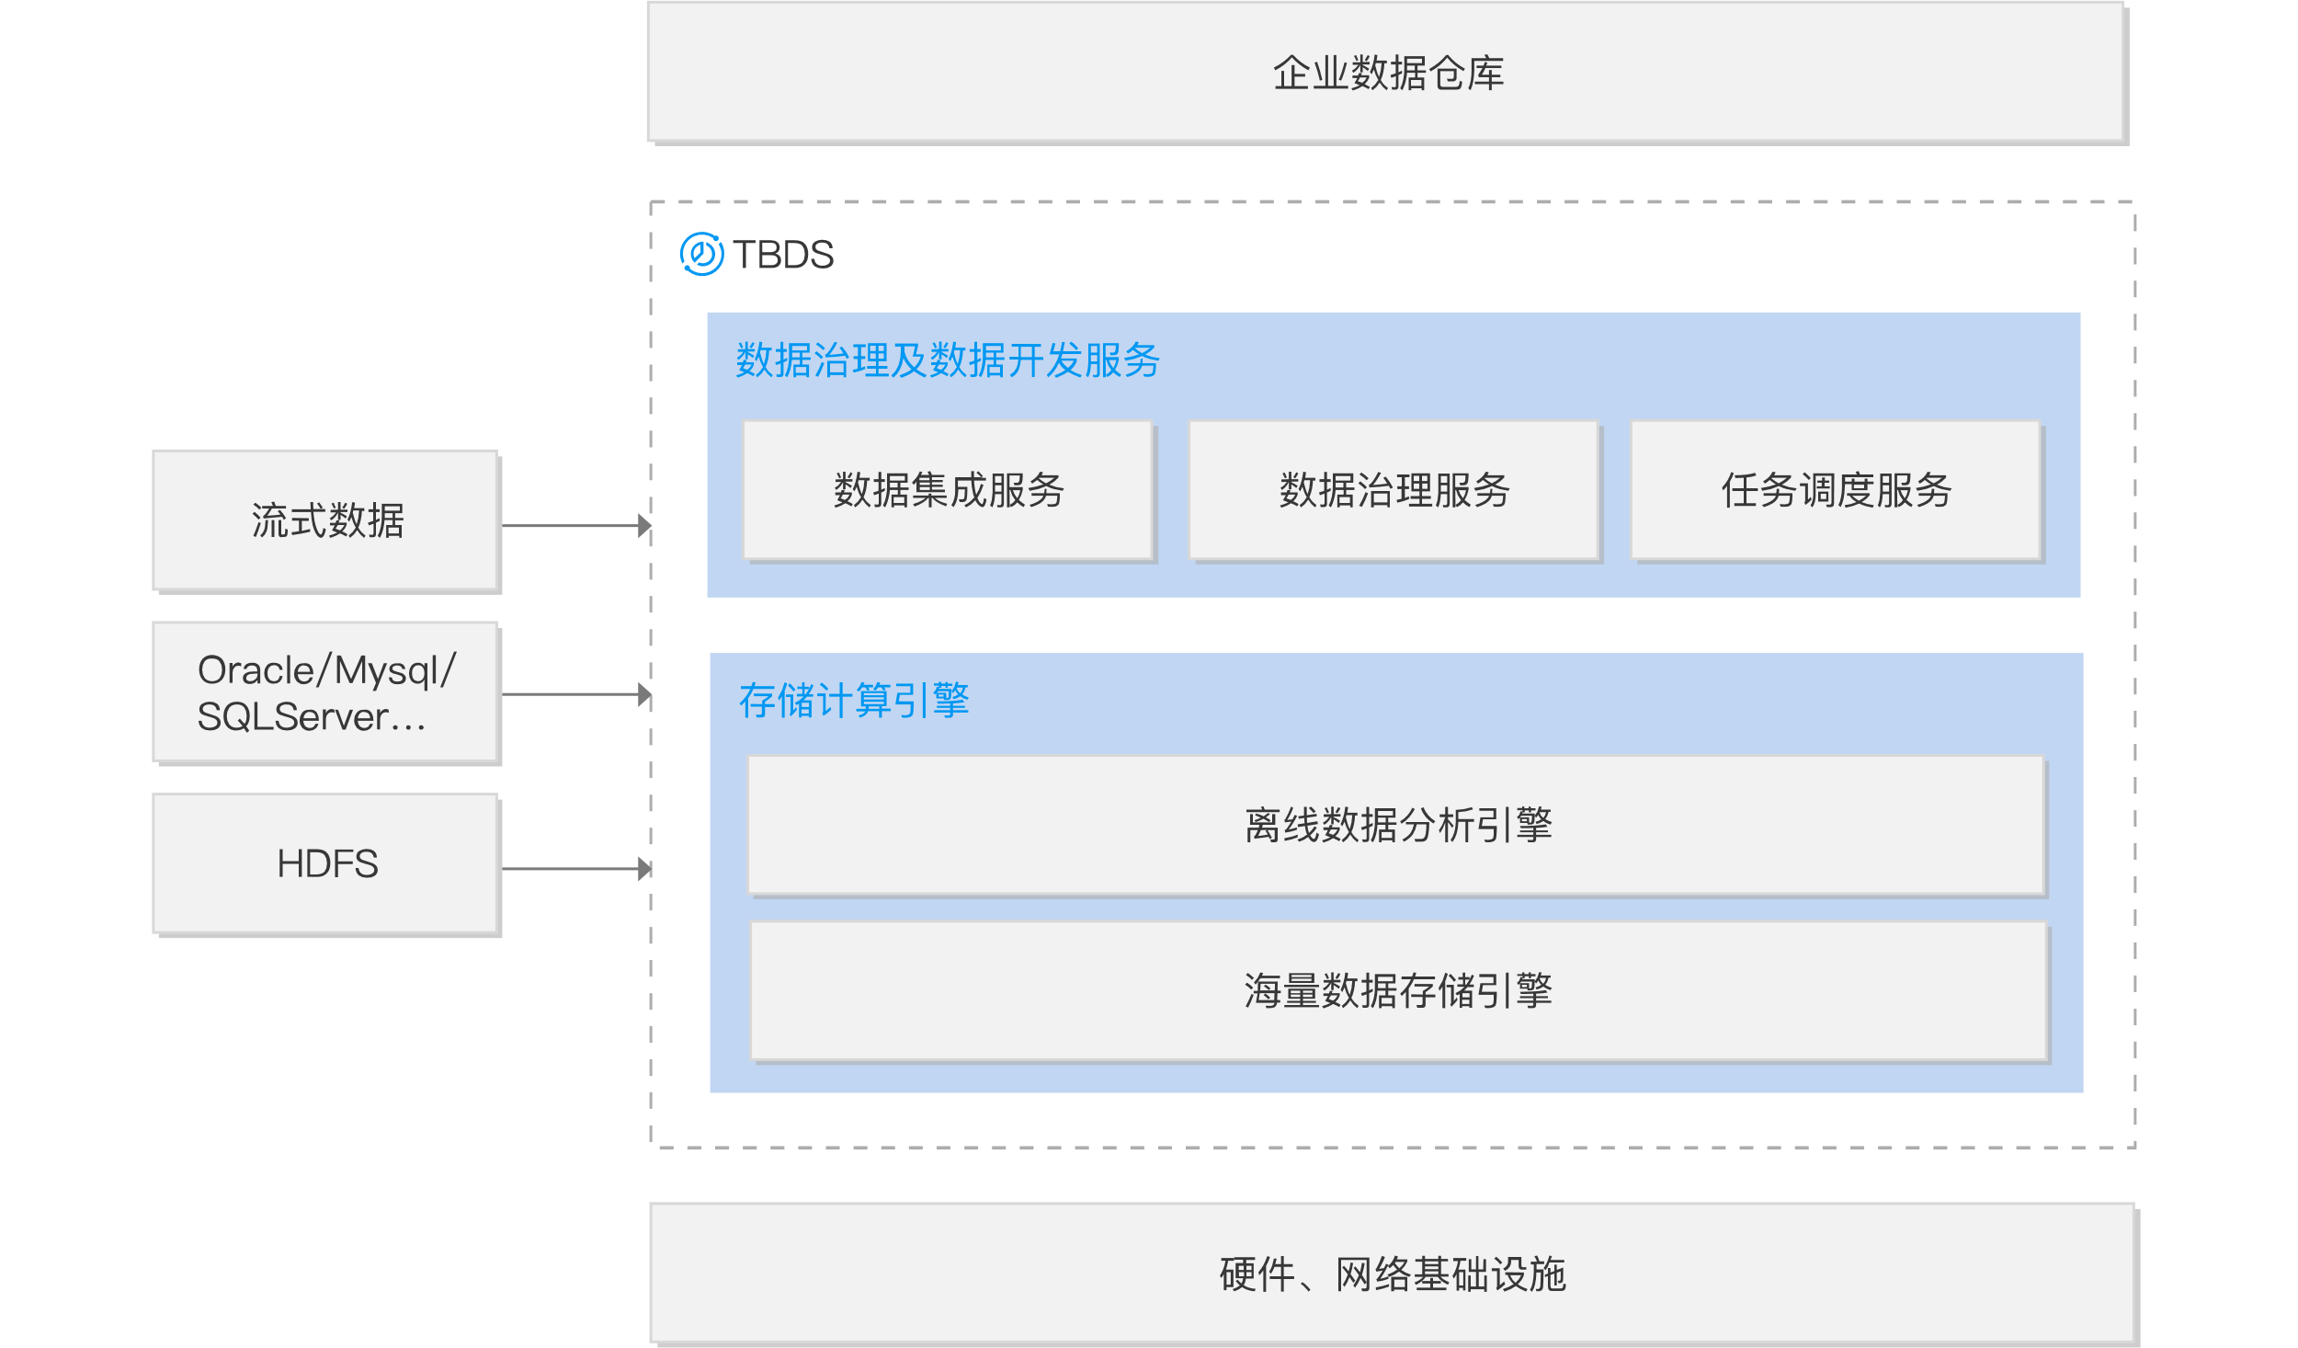
3.3 TBDS (continued)
Data warehouse construction
Notes:
大数据处理套件完整覆盖数据抽取、转换、加载、建模、分析、报表呈现、数据治理等数仓建设环节，用户可借助 TBDS 大数据套件在公有云、私有云、非云化环境快速建设 TB 到 PB 级的企业数据仓库和数据集市，搭建专属的大数据应用。TBDS，用户可显著降低基于企业数据仓库的数据应用开发周期，降低开发成本，还可大大降低数据仓库、数据处理、数据应用的运维成本。

Slide 24
3.4 Sparking
What is Sparking?
Based on the industry-leading Apache Spark framework, Sparking offers a rich set of fully-managed, easy-to-use, and high-performance PB-level cloud data warehousing services. It provides a one-stop solution for big data development and data computing.
Applications of Sparking
Enterprise-wide data asset management
Analysis of high numbers of logs and targeted marketing
Scientific data decision making

Slide 25
3.4 Sparking (continued)
Enterprise-wide data asset management
Notes:
企业全域数据资产管理
在游戏、金融、零售、工业等多个行业，迫切需要对用户行为、人员、采购、销售、资产、供应链等管理和业务数据进行汇总管理和分析，构建完备的企业全域数据视图，以便掌握公司总体经营情况，进行快速精准决策；
云数据仓库套件 Sparkling 通过数据集成工具将分散在传统数据库、业务系统、服务器上的各类数据源汇总，构建公司级别数据地图门户，利用高性能的异构数据源聚合分析能力，进行数据管理和业务价值提炼。

Slide 26
3.5 EMR
What is EMR?
Tencent Cloud Elastic MapReduce (EMR) is a cloud-hosted Hadoop service that features Hadoop cluster deployment, software installation, configuration modification, monitoring and alarming, and elastic scaling, providing individual and enterprise users with a secure and stable big data processing solution.
Applications of EMR
Offline data analysis
Streaming data processing
Analysis of COS data

Slide 27
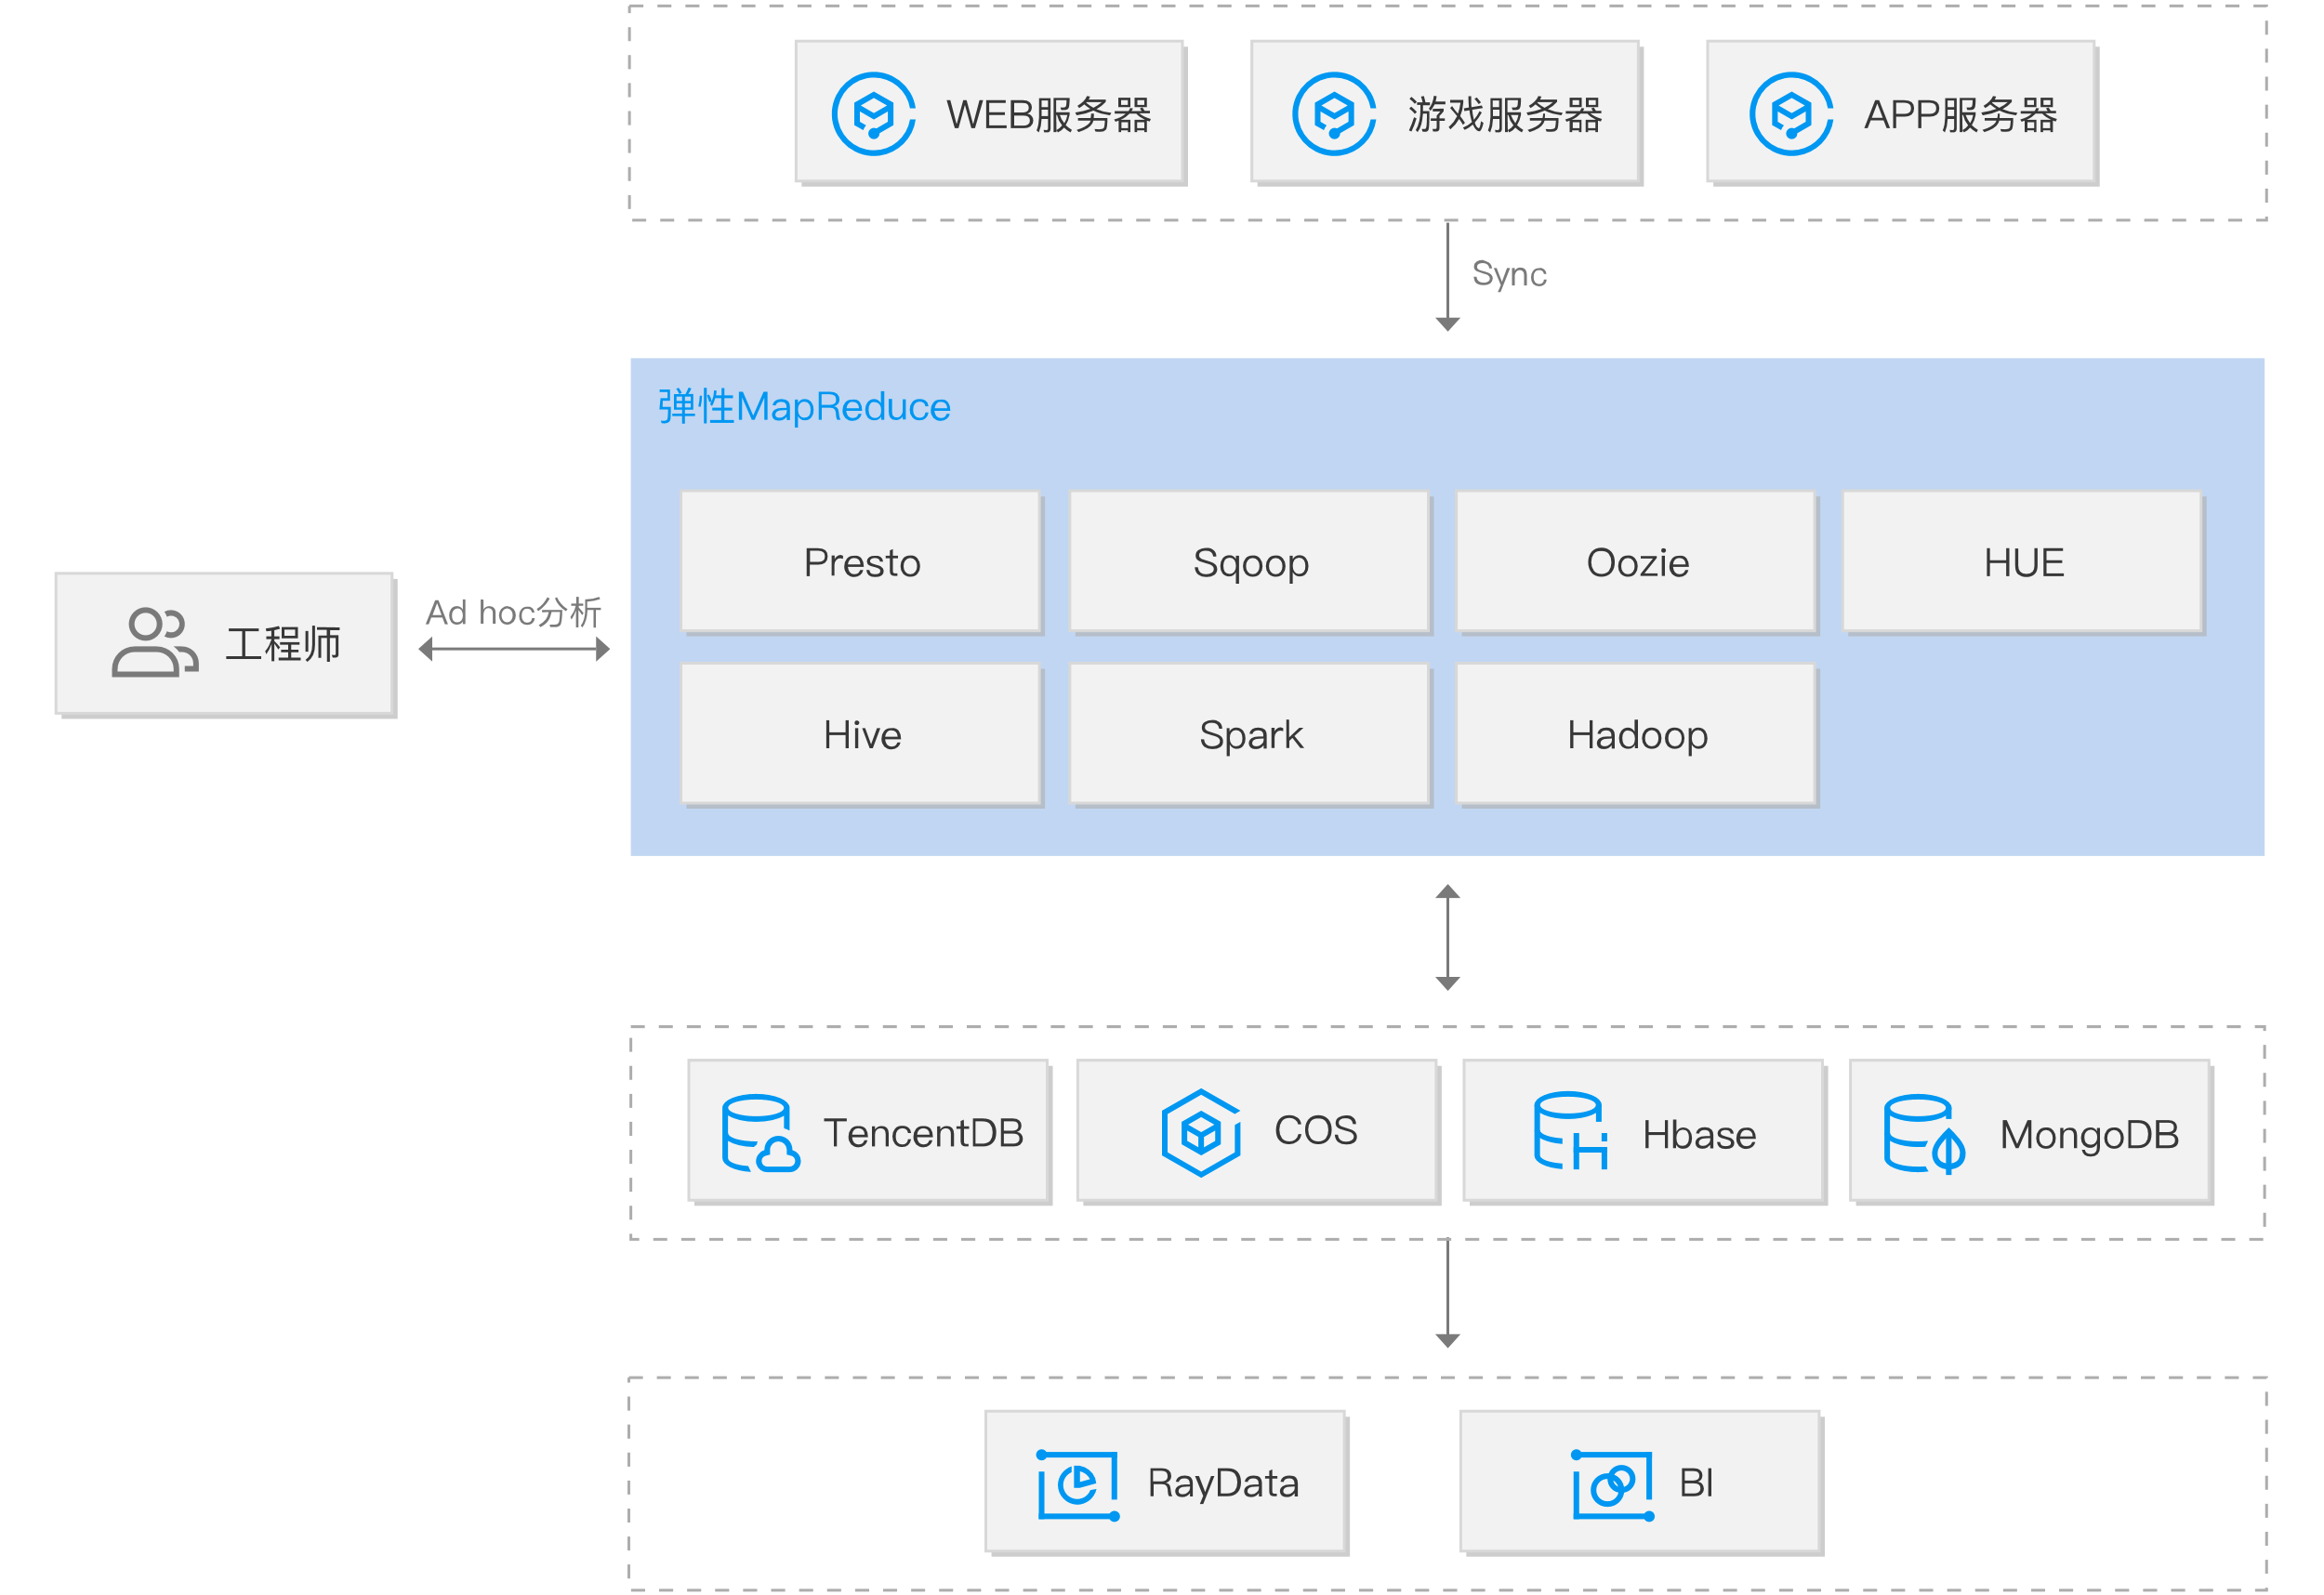
3.5 EMR (continued)
Offline data analysis
Notes:
离线数据分析
把游戏、WEB 应用、手机 APP等业务服务器上的海量日志同步到EMR的数据节点或COS后，您可以借助于Hue等工具使用Hive、Spark、Presto等主流计算框架快速获取数据洞察力。

Slide 28
3.6 Oceanus
What is Oceanus?
Oceanus is a cloud-based streaming data aggregation and computing service.
Applications of Oceanus
Internet clickstream analysis
Real-Time financial risk management
IoT monitoring
Targeted ecommerce recommendation
Notes:
流计算 Oceanus
用户只需几分钟就可以轻松地构建网站点击流分析、电商精准推荐、金融实时风控等流计算应用。全托管的流计算 Oceanus 可实时扩展或缩减计算资源，无须关注基础设施的运维；
同时流计算能便捷地对接云上数据源，为用户提供完善的配套支持。

Slide 29
3.6 Oceanus (continued)
Internet clickstream analysis
Notes:
互联网点击流分析
用户在网站浏览时会产生许多的点击行为，对这些点击行为加以分析可精确把握热点趋势；
借助于云端流计算 Oceanus，能够分钟级构建实时分析，对用户行为数据进行实时汇聚分析，持续地挖掘出有价值信息，帮助更好地做出运营决策，改进用户体验。

Slide 30
3.7 BI
What is BI?
Tencent Cloud Intelligence Business (BI) incorporates the product capabilities of YonghongTech and offers self-service data preparation, exploratory multidimensional analysis, enterprise-grade management, and report representation capabilities. It is a new-generation, agile, and self-service SaaS BI service platform.
Applications of BI
Real-Time data analysis and decision making
Integration of reports into internal systems
Visual dashboard display
Notes:
商业智能分析BI
可通过拖拽式自服务操作进行交互式分析，几分钟完成一套数据可视化报表，快速获得数据分析结果，挖掘数据潜在价值。

Slide 31
3.7 BI (continued)
Real-Time data analysis and decision making
Notes:
数据即时分析与决策
避免引入数据开发工程师对数据预处理和结果提取的流程开销。业务人员无需寻求研发人员编写 SQL 取数来进行数据分析和决策，既可通过 SaaS BI 自助式快速创建报表和仪表盘进行商业决策；
快速进行数据交互式探查。业务人员可通过笔刷联动、过滤器等方式快速对报表进行交互式多维分析和探查，避免重新构建报表的时间开销。

Slide 32
Section 4. Tencent Cloud EMR Solution
Section 1. Evolution of Cloud Computing
4.1 EMR solution for ecommerce platforms
CONTENTS
4.2 EMR solution for gaming platforms

Slide 33
4.1 EMR solution for ecommerce platforms
Background of an ecommerce company
Main business
Ecommerce website specializing in women's fashion
Mission
To become an internet company that features high technology and minimalist fashion and focuses on combining shopping and communities
Requirements
Personalized app recommendation
Website optimization
Social interaction in the theme market
Brand operations trend tracking
Notes:
数据即时分析与决策
避免

Slide 34
4.1 EMR solution for ecommerce platforms (continued)
EMR solution for the ecommerce company
Personalized app recommendation
Website optimization
Social interaction in the theme market
Brand operations trend tracking
Main shopping website clickstreams
EMR
Applications of ecommerce big data
Apparel
Streaming
Real-Time recommendation engine
Footwear
Spark Streaming
Clickstream analysis
Jewelry
Targeted ecommerce recommendation
Feature modeling
User tagging system
Result table
Offline
Ecommerce trading system
Ecommerce dashboard
Hive
Presto
HBase
User information system
Real-Time business trend tracking
Offline
Order analysis platform
Order support system
Spark SQL
Notes:
弹性MapReduce的应用场景非常广，Hbase实现在线业务场景，Hive、SparkSQL、Presto实现数据仓库场景，Sparkstreaming实现实时流式计算场景。
在上述电商企业的EMR解决方案中
购物主站点击流需要实时流式计算组件：Sparkstreaming支持
电商交易系统需要离线计算组件：Hive、Presto等数据仓库组件支撑
通过弹性MR平台的分析处理，可以为电商企业实现：点击流分析、电商精准推荐、电商大屏和实时经营趋势跟踪等电商大数据应用

Slide 35
4.2 EMR solution for gaming platforms
Background of a gaming company
Main business
A digital entertainment platform that provides rich and diverse digital gaming and animation content
Mission
To accumulate high numbers of users and take advantage of lean operations to monetize through advertising and online traffic
Requirements
Precise player targeting
Game project approval analysis
User retention operations
Promotion outcome tracking
Notes:
数据即时分析与决策
避免

Slide 36
4.2 EMR solutions for gaming platforms (continued)
EMR solution for the gaming company
Precise player targeting
Game project approval analysis
User retention operations
Promotion outcome tracking
Multi-Game user data warehouse
EMR
Gaming data analysis system
Behavior data
Profiling engine
Intersection engine
Tracking engine
Offline
User profiling
Multi-Packet merge
User extraction
Attribute data
Drill-down analysis
Multi-Packet intersection
Basic tracking
ETL
Multidimensional intersection
Dashboard intersection
Feature tracking
Profile data
Multidimensional computation
Marketing intervention system
Real-Time log computation
Real-Time user data streaming
Sorting and filtering
Real-Time computing
Scenario engine
Impression
Algorithm model
Channel selection
Cache management
Real-Time storage
Streaming
Click
Real-Time computing
Real-Time rule engine
Algorithm engine
Real-Time intervention
Lucky draw
Number conversion
Sorting computation
Algorithm selection
Real-Time prize awarding
User matching
Threshold optimization
Payment
Ad matching
Real-Time messaging
Log computation
with Redis
Notes:
通过EMR解决方案，构建该游戏公司的游戏数据及经营干预分析平台，能够实现
多场景快捷支撑；
摆脱基础运维工作，聚焦高价值业务经营分析。用户不需要搭建和运维底层的大数据组件和集群，专注运营。

Slide 37
Course summary
This course covers:
The basic concepts, characteristics, and technology framework of big data;
Two modes of big data: real-time and offline computing;
Tencent Cloud big data service system;
Tencent Cloud EMR big data solution.

